Slide 1
SUMMARIZE AN ARTICLE USING ADAPTIVE TEXT SUMMARIZATION API WITH IBM CLOUD

Slide 2
TEAM MEMBERS
L.VINAY REDDY
L.ABHINAY REDDY
M.KRISHNA CHAITANYA
DEEPTHI NAMALA

Slide 3
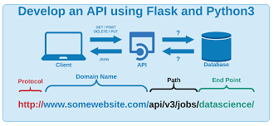
OBJECTIVE
SUMMARIZATION
FLASK APP
How APIs work
BUILDING WEB APPLICATIONS
INPUT/OUTPUT

Slide 4
SUMMARIZATION
With such a big amount of data circulating in the digital space, there is need to develop machine learning algorithms that can automatically shorten longer texts and deliver accurate summaries that can fluently pass the intended messages.
Furthermore, applying text summarization reduces reading time, accelerates the process of researching for information, and increases the amount of information that can fit in an area.
There are important applications for text summarization in various NLP related tasks such as text classification, question answering, legal texts summarization, news summarization, and headline generation. Moreover, the generation of summaries can be integrated into these systems as an intermediate stage which helps to reduce the length of the document.
In the big data era, there has been an explosion in the amount of text data from a variety of sources. This volume of text is an inestimable source of information and knowledge which needs to be effectively summarized to be useful. This increasing availability of documents has demanded exhaustive research in the NLP area for automatic text summarization.

Slide 5
TYPES OF SUMMARIZATION
There are two main types of how to summarize text in NLP:
Abstraction-based summarization
The abstraction technique entails paraphrasing and shortening parts of the source document. When abstraction is applied for text summarization in deep learning problems, it can overcome the grammar inconsistencies of the extractive method.
The abstractive text summarization algorithms create new phrases and sentences that relay the most useful information from the original text — just like humans do.
Therefore, abstraction performs better than extraction. However, the text summarization algorithms required to do abstraction are more difficult to develop; that’s why the use of extraction is still popular.
Extraction-based summarization
The extractive text summarization technique involves pulling key phrases from the source document and combining them to make a summary. The extraction is made according to the defined metric without making any changes to the texts.

Slide 6
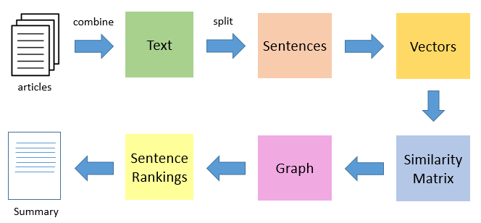
FLASK

Slide 7
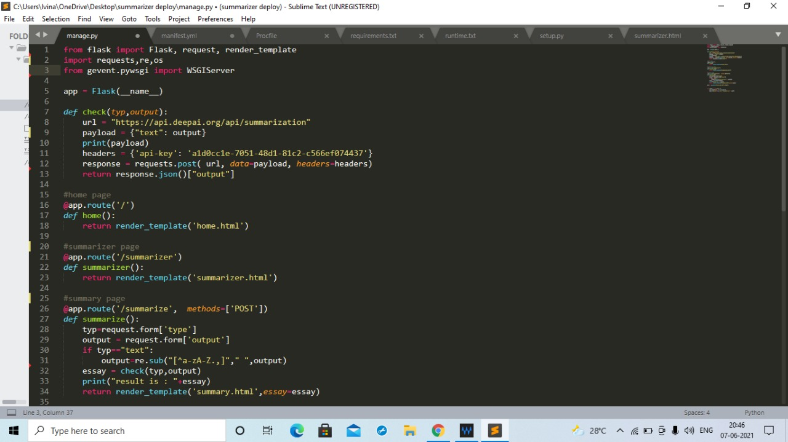
FLASK CODE

Slide 8
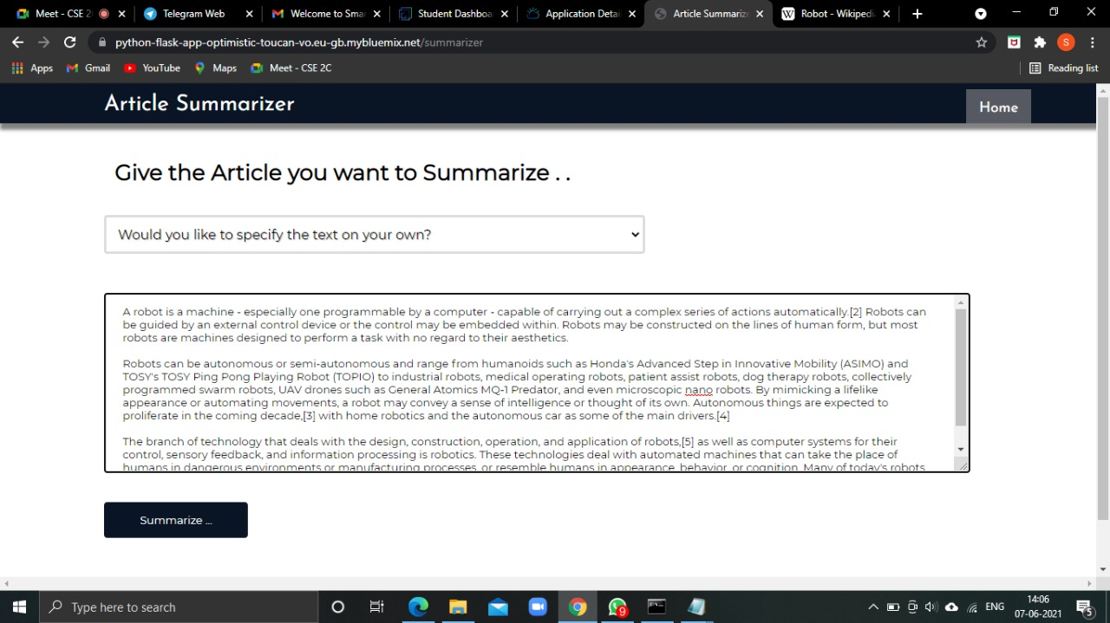
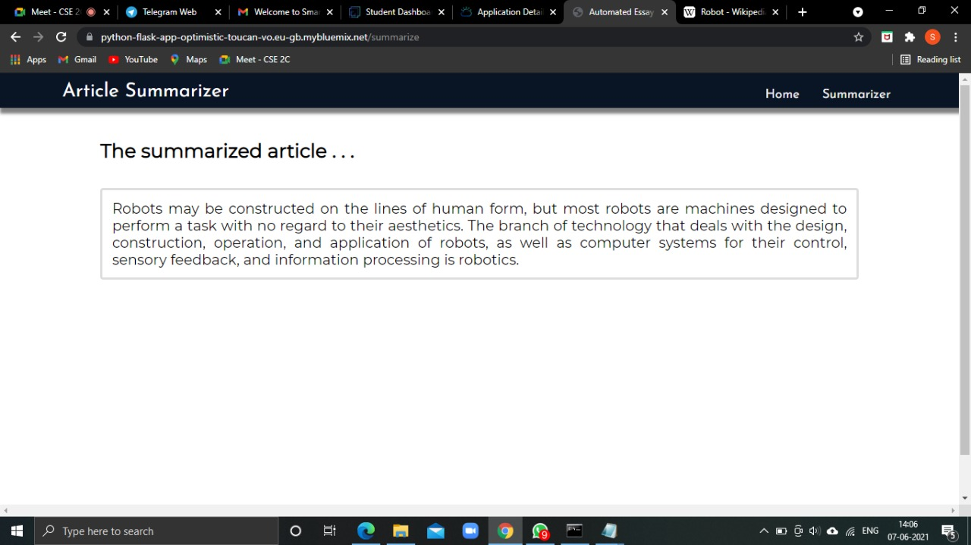
INPUT/OUTPUT

Slide 9
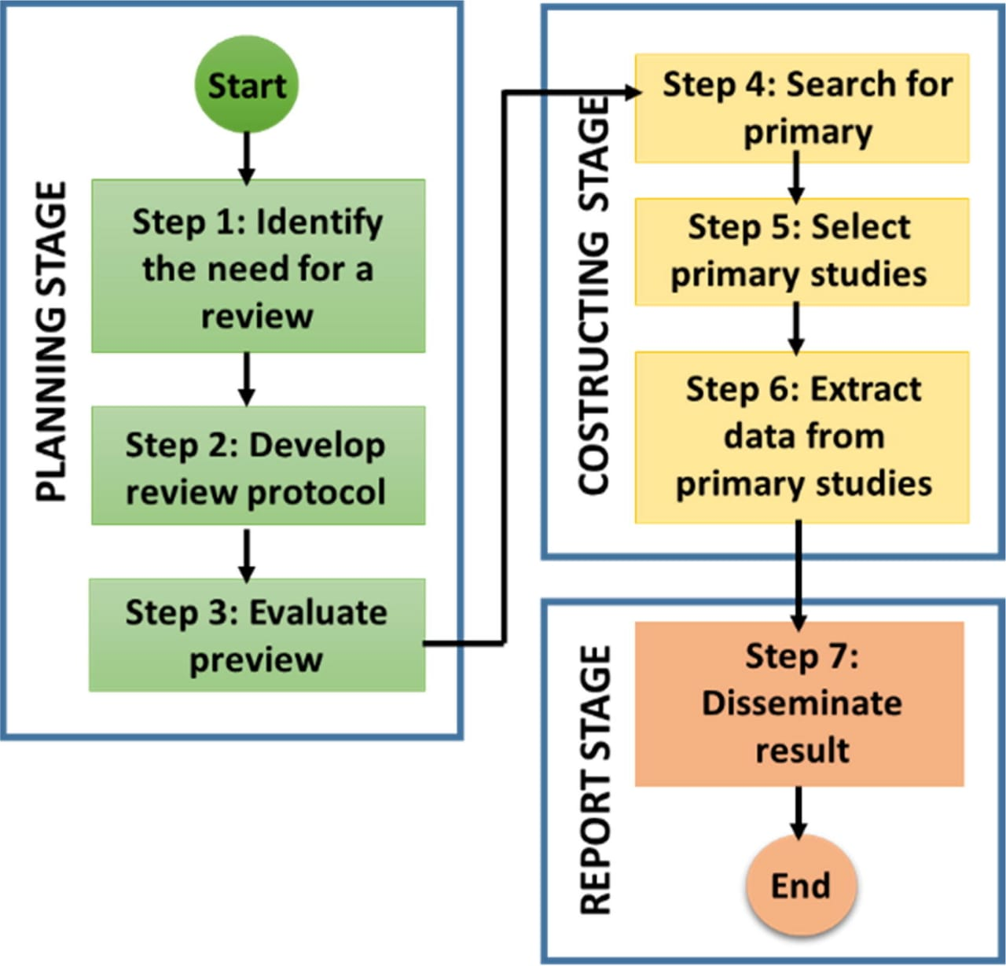
ADVANTAGES AND DISADVANTAGES
Advantages
Can be an aid to identify
Troublesome questions
Difficult concepts
Respondent reactions to new data collection techniques
Disadvantages
Yet, many problems can go by unnoticed
Respondents may Misunderstand questions
Use inappropriate judgment strategies
Provide socially desirable answers

Slide 10
CONCLUSION
Word clouds are beautifully insightful with pros and cons. Word clouds can allow you to share back results from research in a way that does not require an understanding of the technicalities. Some of the pros are below.
It reveals the essential.
They are fast & engaging. As observed, skilled interpretation is what provides the beautiful insights.

Slide 11
THANK YOU ☺

